Slide 1

Strategic Planning Board Review
Dunklin R-V School District
June 16, 2015

Slide 2
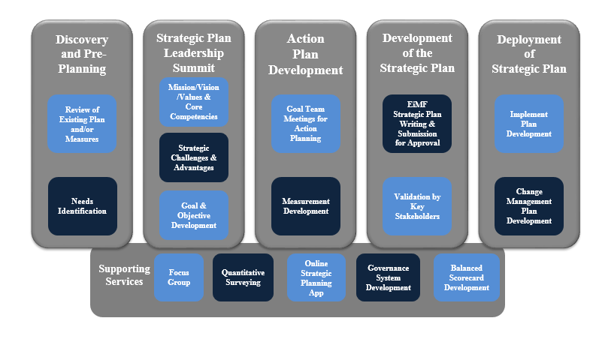
Strategic Planning Process

Slide 3
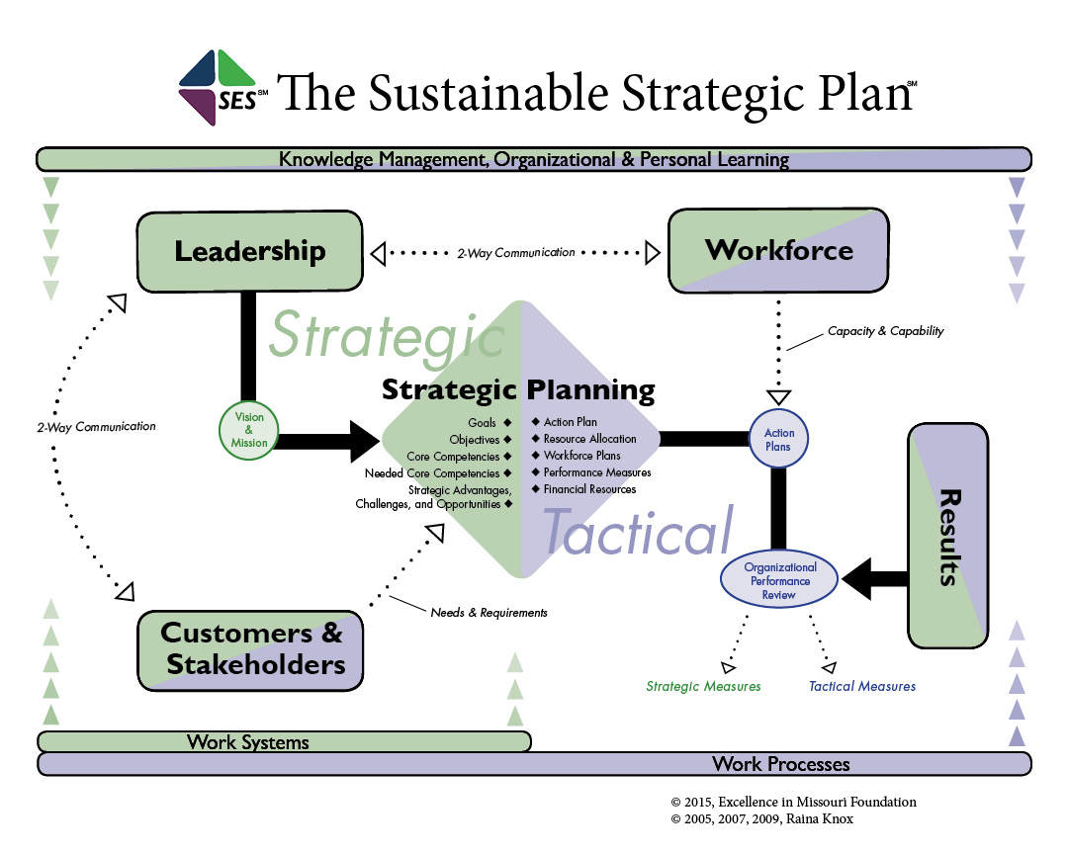

Slide 4
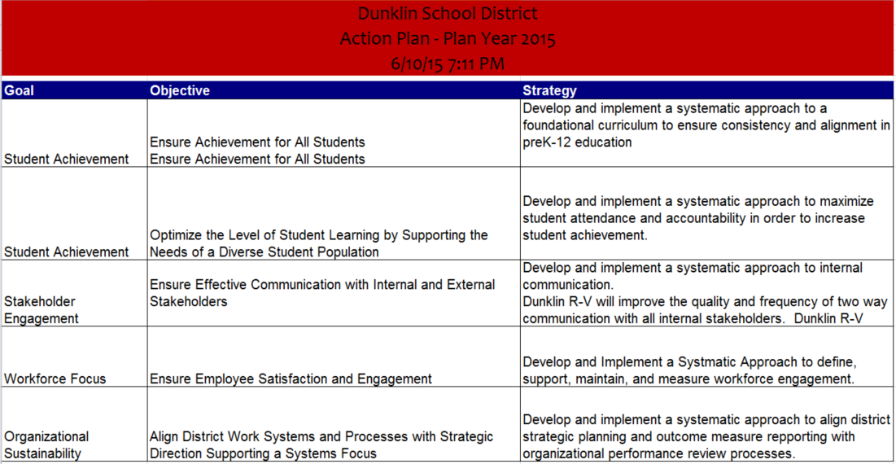
The Strategies for Year One

Slide 5
Resource Requirements

Slide 6
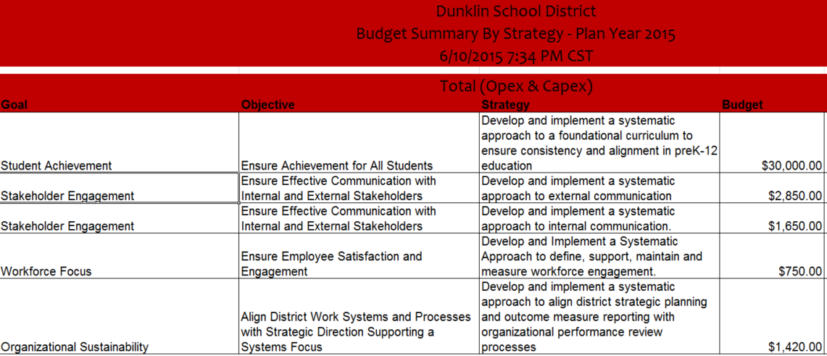
Budget Requirements

Slide 7
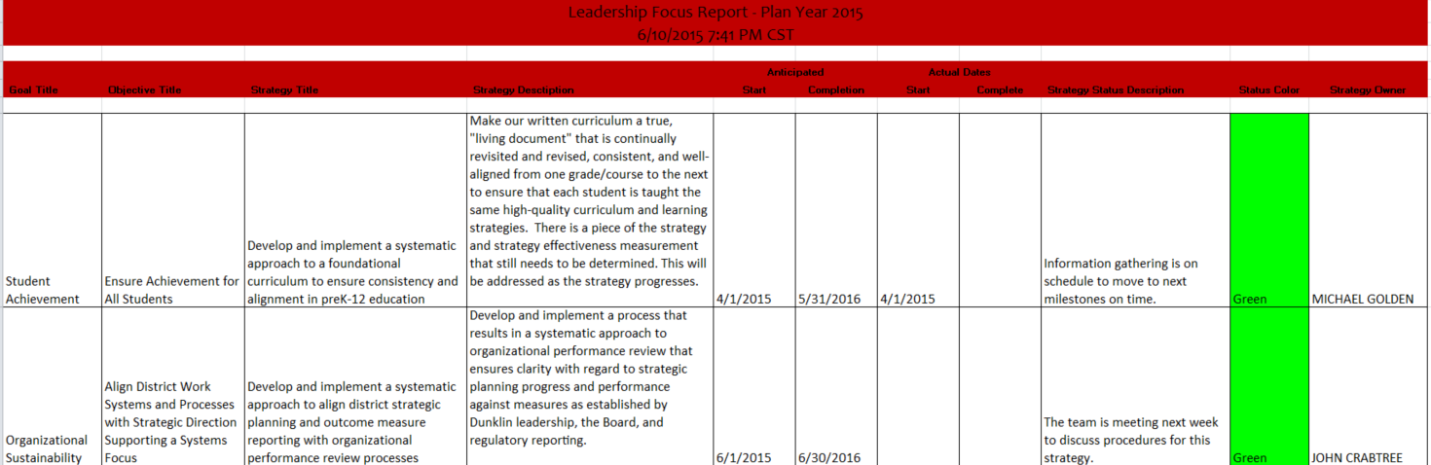
Monthly Leadership Review

Slide 8
Strategic Measures
To be Provided at Board Meeting-Under Development

Slide 9
Development of Monthly Review Plan and Yearly Update of Plan
Ongoing Review Plan
Strategic Plan Management Flow
Long-Term Direction Established
Tactical View of Progress Against
Action Plans Established
Annual Review Process
Five Year Strategic Plan
-Mission
-Vision
-Goals
-Objectives
One Year Action Plans
Tactical plans established each year
Implementation Plans
Plans used to execute action plans and report status throughout the year
Dashboard
Provides the monthly review of organizational progress against action plans
Review and Realignment of Strategic Plan Annually
-Leadership Team
-Board of Education
-Goal Teams
-Employees and Departments

